Slide 1
Project Gladiator
GOIBIBO.com
Set-3, Group-7

Slide 2
Automation Testing on GOIbibo
Project Members
Yamuna.K Shravani shinde
Yadav Rajendra Chaudhari Shruthi kadaganchi
Under the Guidance of
Aditi Patil (SME) Saranya (Trainer)

Slide 3
Table of Contents
Abstract
Introduction
Requirement Analysis
Testcases Scenario
Testcases Design
Automation Gathering
Automating Testcases
Screenshots
Reports.

Slide 4
Abstract
It is an Automation related project. We have Automated the Goibibo web platform (https://www.goibibo.com) using Selenium which is an open-source tool used for automation, Java technologies, Page Object Model, Framework, TestNG have been used.
In this project we are discussing about Requirement Analysis ,Test Designing, Test cases and Taking Screenshots and extents the Report using Automation, Java technologies.

Slide 5
Introduction
In GOIbibo Website we are testing the signup page , registration page , Flight booking page and Hotel room booking page.
By using Selenium which is an open-source tool used for automation, Java technologies, Page Object Model, Framework, TestNG have been using to test the Website.
In this project We are going to see how was Automation testing is performed by using above mentioned tools

Slide 6
Requirement Analysis
In this module , we are going to learn how to design the requirement analysis .
What is purpose of requirement analysis?
Requirement analysis is a key sheet of preparing the test scenarios and test cases. It gives the overall idea to design the test cases.
This sheet describes about customer requirement and operations.

Slide 7
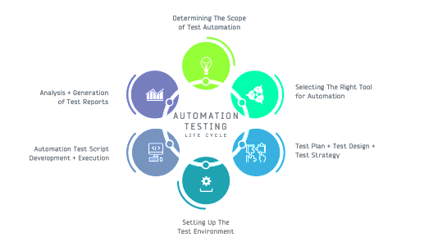
Requirement Analysis Cont’d.

Slide 8
Testcase Scenario
In this module, we learn about the Testcase Scenario
It is useful to design the testcases, this is performed by Test Engineer( Quality Assurance).
Here, we divide the total work into small tasks, to perform the test cases and in testing
For Example:
Login page Scenario
Registration Scenario
Flight Booking Scenario
Hotel Booking Scenario

Slide 9
Testcase Design
In these module, we are going to see the Testcase Design.
Here, we are Writing the Test cases to test the Website
Using both positive Test cases and negative test cases.
Then, we will come Know the Website is working as per the customer requirement and satisfying the user interface also.

Slide 10



Automation Gathering
In this module, We are going to see which Technologies are using to test the website
Java Technologies
Selenium source
Eclipse IDE

Slide 11
Automating the Test cases
By using the above technologies, we are using to test the websites.
The designed test cases are testing by automation.
Observed that the test cases are performed as per the client requirement and user satisfaction.
The test cases are automated in different scenarios and environment.

Slide 12
Screenshots
By automating the test cases , we are also take screenshots by using those platform.
Screenshots are used to show the client that, we are automated as per your requirement.
And it is used for in future to prove that , you tested all the testcases and scenarios.

Slide 13
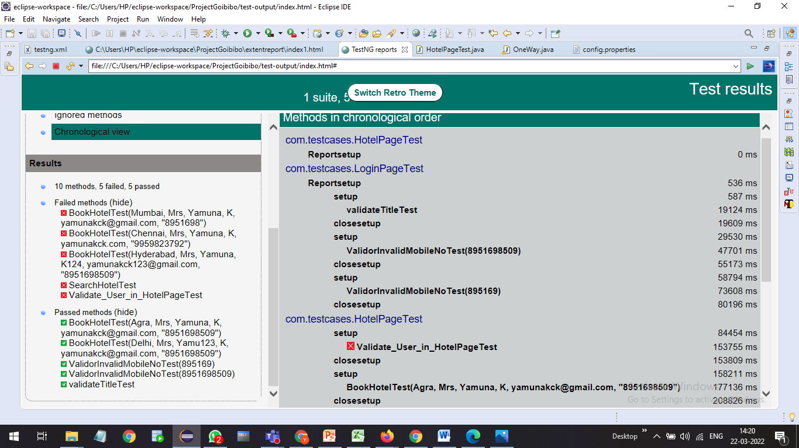
Reports
In this Reports , we are extracting the final result of all test cases.
Report generated for Login/Sign-Up , Hotel and Flight Booking in GOIbibo.

Slide 14
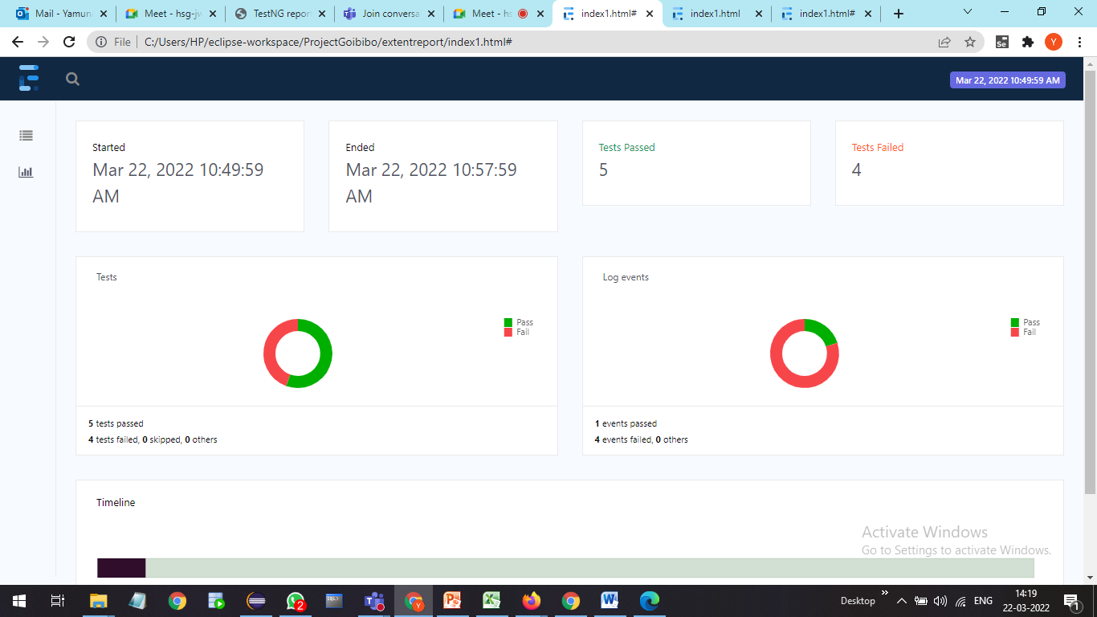
Extent Report for Login, Registration and Hotel Booking

Slide 15
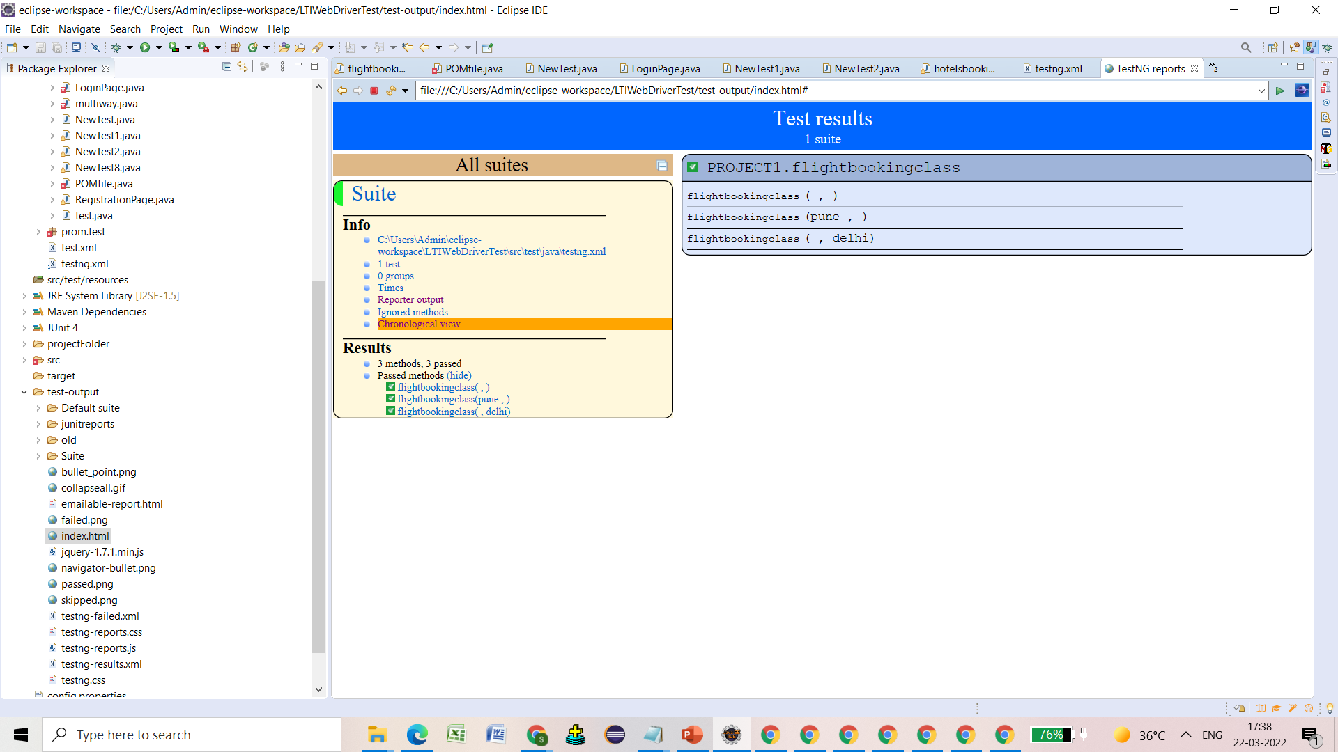
Report Generated for Positive TestCases of Flight Booking

Slide 16
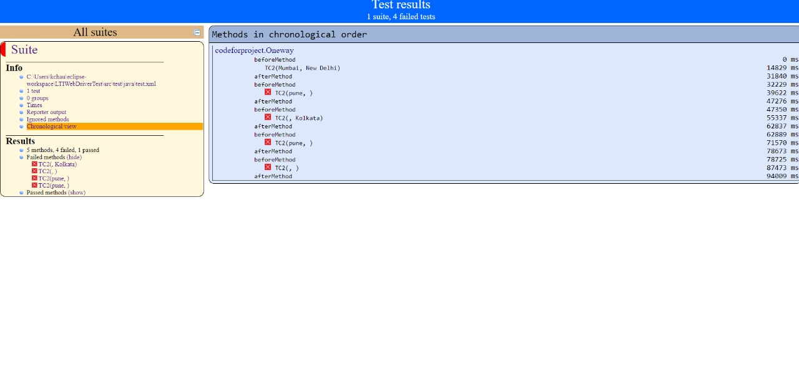
Report generated for negative Testcases of Flight Booking

Slide 17
Artifacts
We observed that the website fully functioning as per the client requirement.
And it is performing as user friendly environment.
This are the test cases we have done on the website
Login page
Registration page
Search for flight and booking
search for Hotel and booking
We conclude that the website is ready to deploy and maintenance as per the client requirements.

